Slide 1
Skip Connections Matter: On the Transferability of Adversarial Examples Generated with ResNets[1]
Presented By:
Austin Cozzo
Anurag Chowdhury
[1] Wu, Dongxian, Yisen Wang, Shu-Tao Xia, James Bailey, and Xingjun Ma. "Skip Connections Matter: On the Transferability of Adversarial Examples Generated with ResNets." In International Conference on Learning Representations. 2019.

Slide 2
What are Adversarial Examples?
Given a high-dimensional input vector $x$, and a classification mapping $f:ℝ^{d}→\left\{1,2,3,…c\right\}$, an adversarial example is a particular $x$ such that for some perturbation vector $η$:
$x^{′}=x+η$ $f\left(x^{′}\right)≠f(x)$
Typically, some norm ($‖⋆‖$) of $η$ is constrained, such that $ε≥\left\|η\right\|$, where $ε$ is a hyperparameter

Slide 3
What Makes a Neural Network Vulnerable to Adversarial Examples?
The critical component of generating adversarial examples is the perturbation vector $η$
Neural Networks, particularly Deep Neural Networks (DNNs), create high-dimensional embeddings which are largely intractable and can be highly sensitive to these kinds of perturbations
Moreover, the gradient of the DNNs pose a large indicator as to a potential perturbation vector

Slide 4
How Can We Create Adversarial Examples for Deep Neural Networks?
When the classification mapping is DNN, a gradient of the loss function with respect to the input vector $∇_{x}ℓ\left(f\left(x\right), y\right)$, where $y$ is the ground truth class label, can provide a simple indication of a potential perturbation vector
For example, consider the Fast Gradient Sign Method (FGSM) [1] which is very simple on the surface, but can obtain $≥90\%$ error rates with this generation method
$$x^{′}=x+ε sign\left(∇_{x}ℓ\left(f\left(x\right), y\right)\right)$$
[1] I. J. Goodfellow, J. Shlens and C. Szegedy, "Explaining and Harnessing Adversarial Examples," in International Conference on Learning Representations, 2015.

Slide 5
White- and Black-Box Approaches
FGSM is considered a white-box approach, where complete knowledge of the DNN is available – including the values of all learned parameters.
White-box attacks have poor generalization and require access to the DNN, which in terms of a real-world attack scenario is relatively unlikely.

Slide 6
White- and Black-Box Approaches
Conversely, a black-box approach knows nothing about the underlying model. There are two major subgroups of black-box approaches
Host models: These methods rely on using a host DNN to train a generation model with the hopes that it generalizes well to other DNNs.
Black-box optimizations: These methods query the target DNN repeatedly in an attempt to uncover the gradient of the target network

Slide 7
Grey-Box Approaches
A “grey-box” approach uses some inferred knowledge about the target DNN to help to create the perturbation vector
For this particular example, we assume that a DNN has skip connections in the architecture, but do not know anything else about the network.

Slide 8
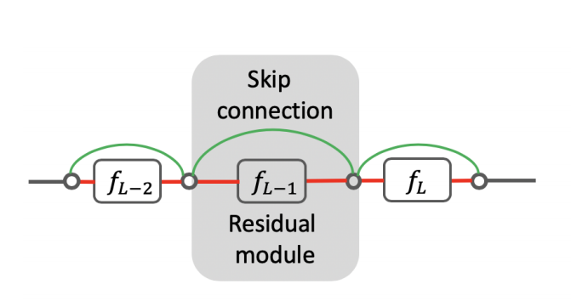
Role of Skip Connections in Deep Learning
Skip connections are bridges which skip over a layer in a DNN. Such a layer and connection is considered a residual module. [1]
Networks with multiple parallel skip connections are considered dense networks [2]
Skip connections allow for DNNs to contain more layers, making a deeper network, while not losing the information from earlier layers despite the increased depth
Figure: An example of a residual module with (grey box), skip connection (green arcs), and typical neuron connection (red lines). Replicated from [3]
[1] A. Veit, M. J. Wilber and S. Belongie, "Residual Networks Behave LIke Ensembes of Relatively Shallow Network," in Conference on Neural Information Processing Systems, 2016.
[2] G. Huang, Z. Liu and K. Q. Weinberger, "Densely Connected Convolutional Networks," in Conference on Computer Vision and Pattern Recognition, 2016.
[3] Wu, Dongxian, Yisen Wang, Shu-Tao Xia, James Bailey, and Xingjun Ma. "Skip Connections Matter: On the Transferability of Adversarial Examples Generated with ResNets." In International Conference on Learning Representations. 2019.

Slide 9
Skip Gradient Method
Because skip connections present another gradient to examine, the authors of [1] consider the gradient of these residual modules.
$$∇_{x}ℓ=\frac{∂ℓ}{∂𝓏_{L}}\prod_{i=0}^{L−1}{\left(γ\frac{∂f_{i+1}}{∂𝓏_{i}}+1\right)\frac{∂𝓏_{0}}{∂x}}$$
Here $𝓏_{0}=x$ is the input of the network, $γ∈(0,1]$ is the decay parameter, $f_{i}$ is the layer’s output, and $z_{i}=z_{i−1}+f_{i}(z_{i−1})$ is the skip connection from the previous layer
[1] Wu, Dongxian, Yisen Wang, Shu-Tao Xia, James Bailey, and Xingjun Ma. "Skip Connections Matter: On the Transferability of Adversarial Examples Generated with ResNets." In International Conference on Learning Representations. 2019.

Slide 10
Skip Gradient Method
Using this gradient, an adversarial example can be constructed iteratively with the formulation
$$x_{adv}^{t+1}=\prod_{ε}{\left(x_{adv}^{t}+α⋅sign\left(\frac{∂ℓ}{∂𝓏_{L}}\prod_{i=0}^{L−1}{\left(γ\frac{∂f_{i+1}}{∂𝓏_{i}}+1\right)\frac{∂𝓏_{0}}{∂x}}\right)\right)}$$

Slide 11
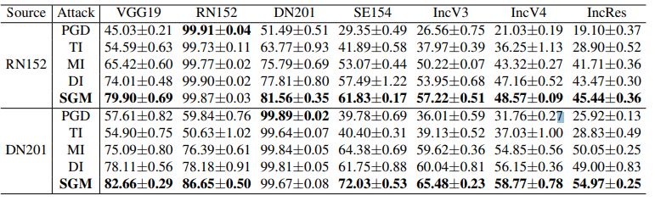
Transferability of the Skip Gradient Method
The authors of [1] show that the skip gradient method retains state-of-the-art performance to a variety of networks with residual modules
Networks evaluated: VGG19, ResNet, DenseNet, InceptionNet
Table: Transerability experiments – the success rates ($\%±stdev$ over 5 random runs) of black-box attacks and the grey-box skip gradient method. Replicated from [1]
[1] Wu, Dongxian, Yisen Wang, Shu-Tao Xia, James Bailey, and Xingjun Ma. "Skip Connections Matter: On the Transferability of Adversarial Examples Generated with ResNets." In International Conference on Learning Representations. 2019.

Slide 12
Summary
Adversarial examples rely on the generation of a suitable perturbation vector
For DNNs, the gradient gives the greatest insight for currently explored adversarial example generation methods
By utilizing an assumption about the underlying network architecture, the skip gradient method is able to create a generation method on a host network and perform at state-of-the-art levels on a variety of networks with skip connections.

Slide 13
Next Steps (Proposed Experiments)
Understanding the classes of perturbation vectors generated with grey-box methods such as the skip connection method
Can potentially be learned by creating a large number of adversarial examples and clustering the resultant perturbation vectors
Understanding the ability to transfer domains with generation models which utilize grey-box methods
Does a model which can produce good adversarial examples on networks trained on ImageNet perform well for adversarial examples on other networks?

Slide 14
Thank You

